Slide 1
Module 5.2 Plotting on a Map
Python for Data Processing

Slide 2
Contents
Contour plot
Plotting an image
Plotting points on a map
Geopandas
Loading and plotting shape files
Coordinates
Clip data based on shape

Slide 3
Contour plot
With the package matplotlib we can plot contour maps
We will look at three options:
Normal contour plot
Labelled contour plot
Filled contour plot
The contour plot function takes at least three inputs: lon, lat, data

Slide 4
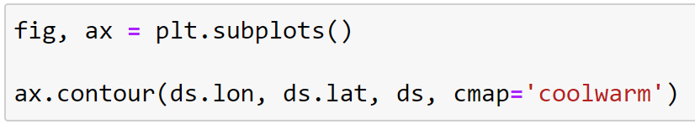
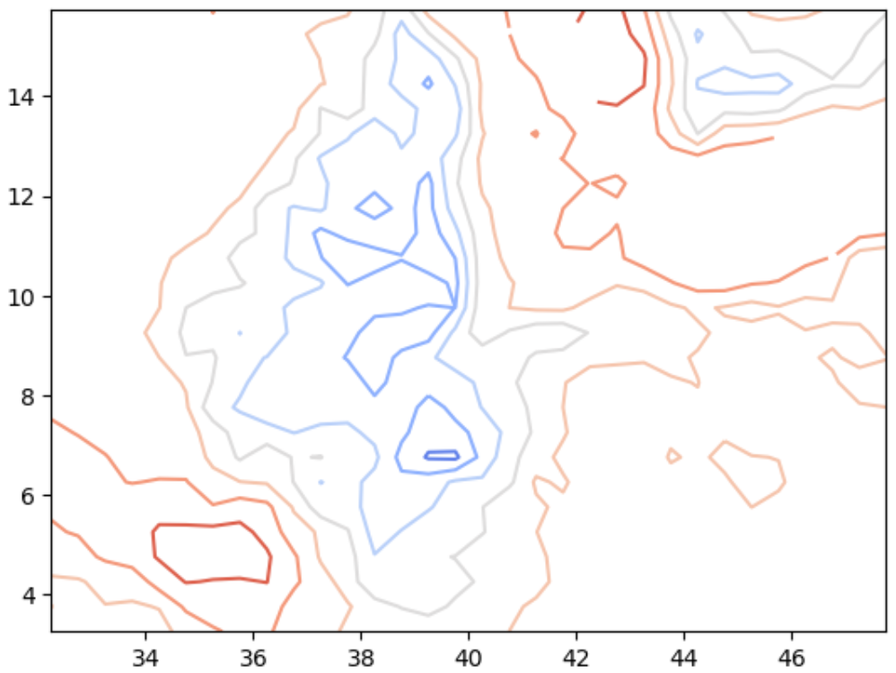
Contour plot

Slide 5
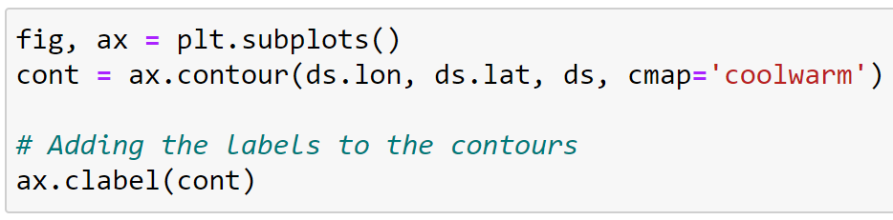
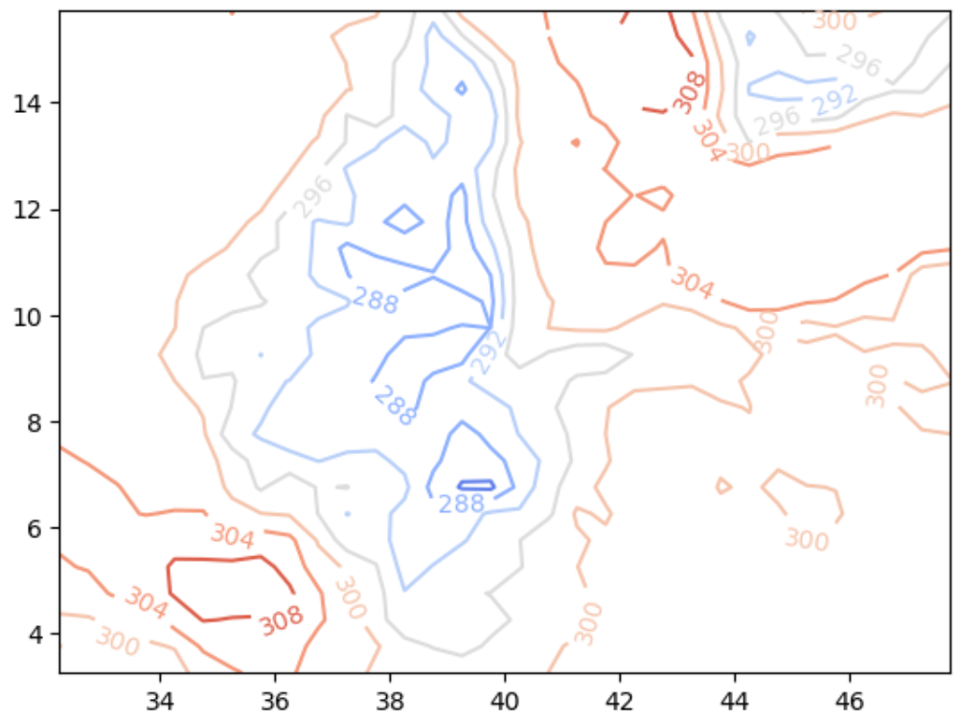
Contour plot

Slide 6
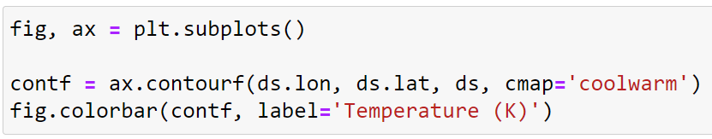
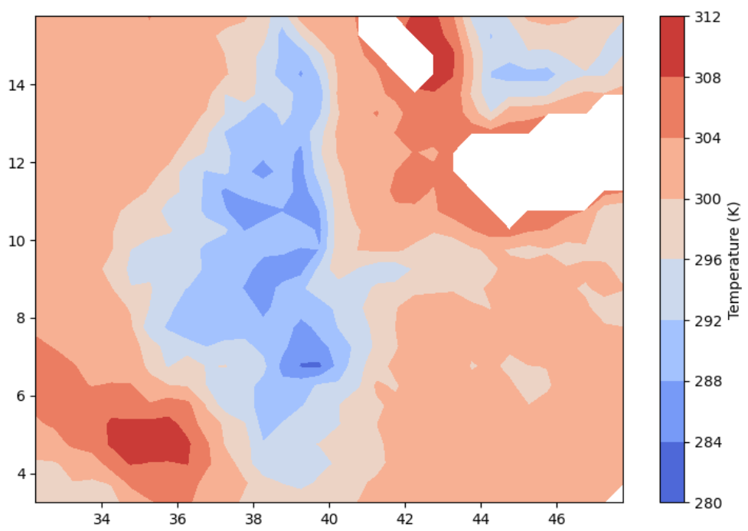
Contour plot

Slide 7
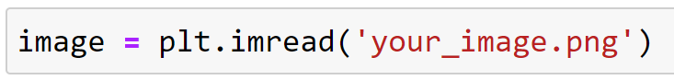
Plotting an image
Python is able to plot an image of map
This takes two steps:
Reading the image
Showing the image

Slide 8
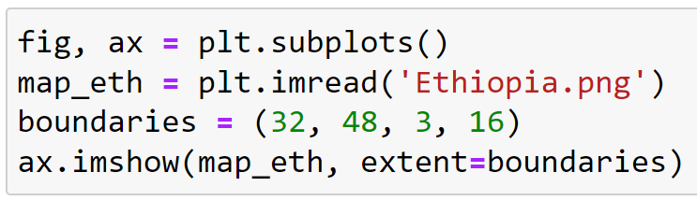
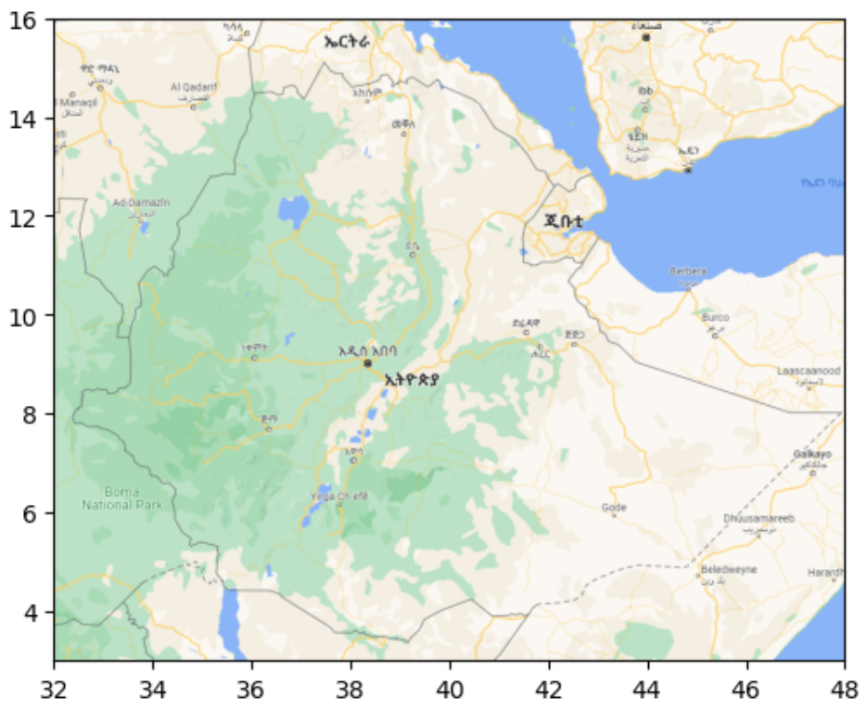
Plotting an image

Slide 9
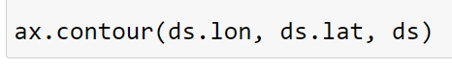
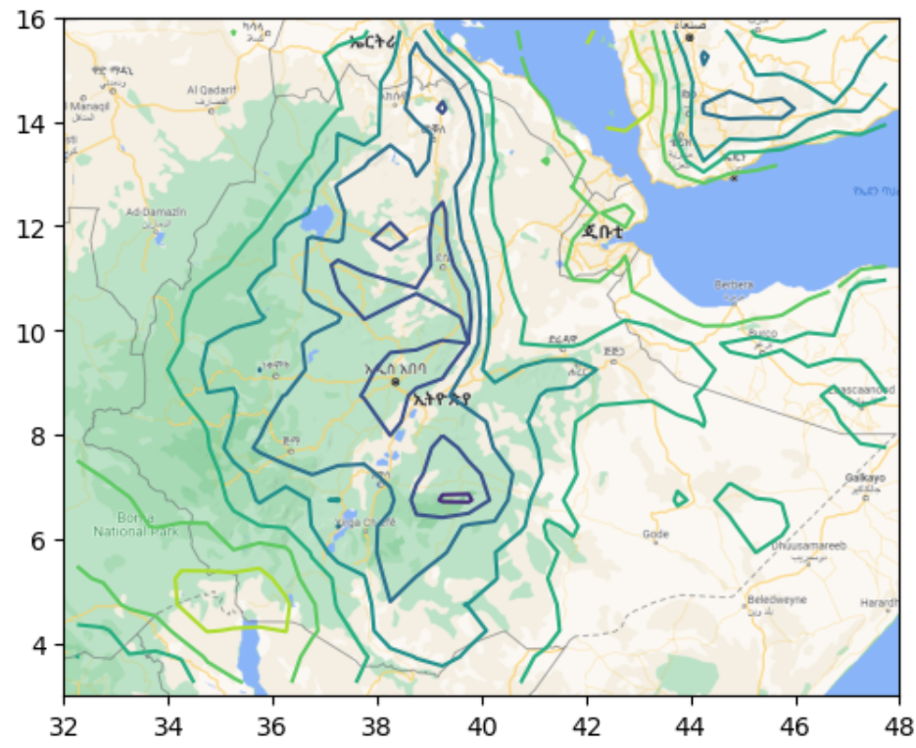
Plotting an image

Slide 10
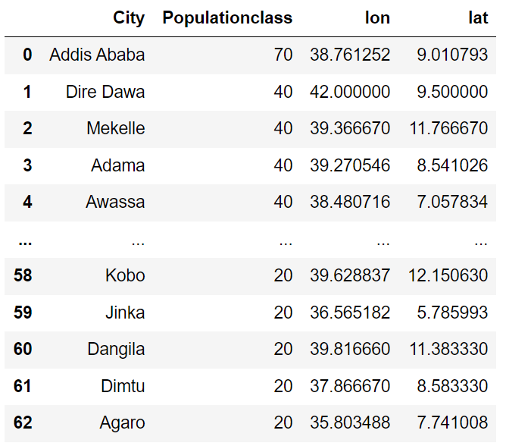
Plotting points on a map
Using the function ax.scatter(), you can add points to a map
You need the coordinates of the points
We can change color, size or shape to show some information

Slide 11
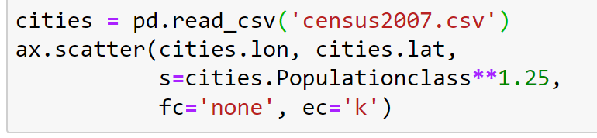
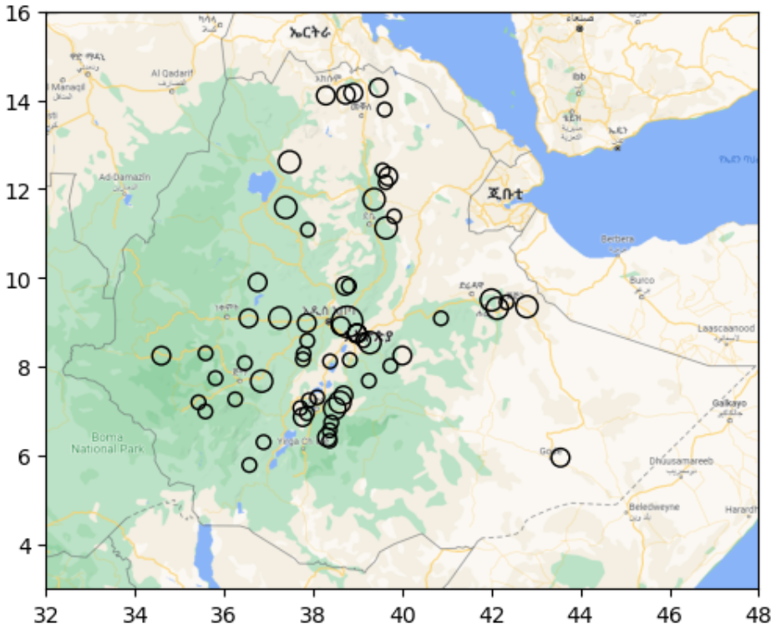
Plotting points on a map

Slide 12
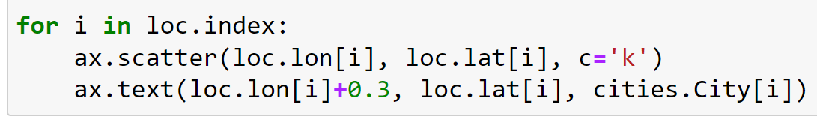
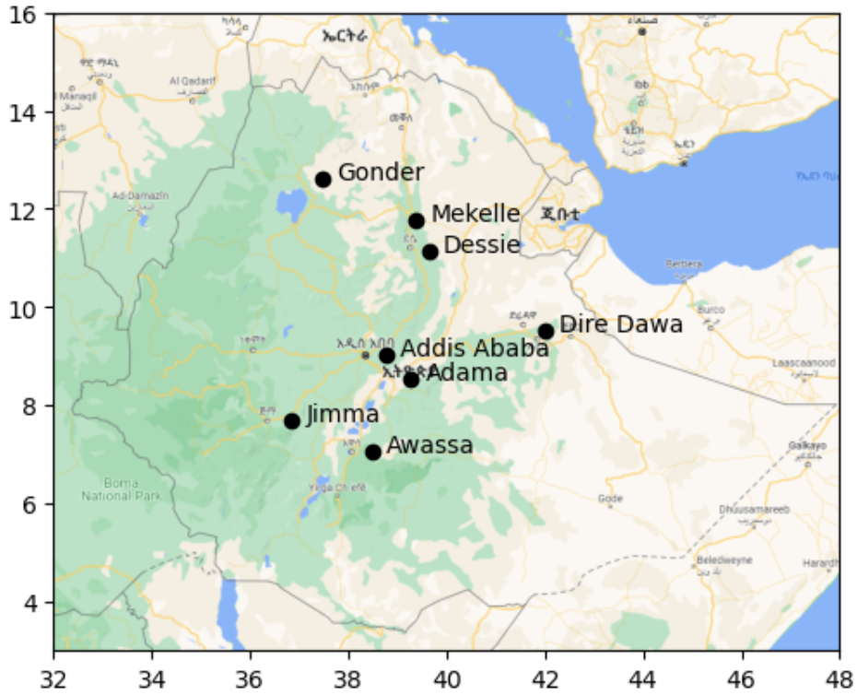
Plotting points on a map

Slide 13
Geopandas
Geopandas is just like pandas, but it can store geographical data very well (inside a GeoDataFrame)
Points; Lines; Polygons
Some relevant uses
Loading and plotting shape files
Align different Coordinate Reference Systems
Create geometry points
Clipping data based on shape

Slide 14
Geopandas – Conda environment
To use Geopandas, we need to work in an environment that contains the package Geopandas
Instead of just opening Jupyter Notebook, we need to open it via the Anaconda prompt
In the Anaconda promt, type: conda activate geo_env
For some, the environment name (geo_env) may be different
Then type: jupyter-notebook
Now Jupyter Notebook will be opened in the correct environment

Slide 15
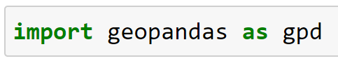
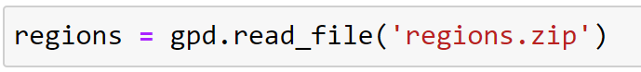
Geopandas – Loading shape files
Loading a shapefile can be done using the function gpd.read_file()
This will create a GeoDataFrame
The difference between a normal DataFrame and a GeoDataFrame is that the latter contains a column with geometry data

Slide 16
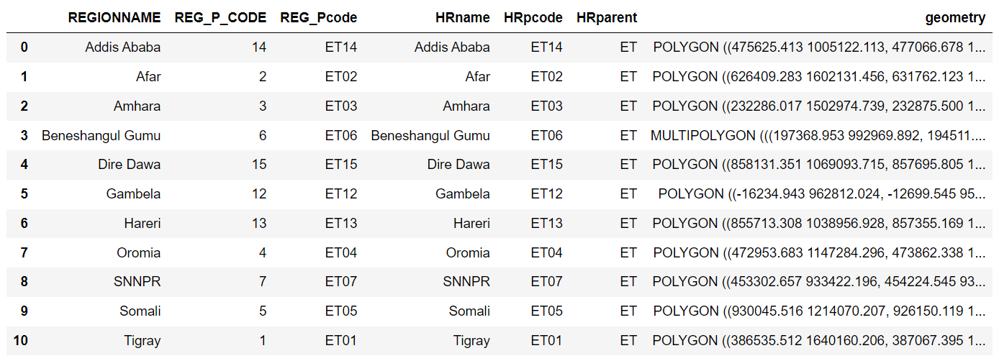
Geopandas – Loading shape files

Slide 17
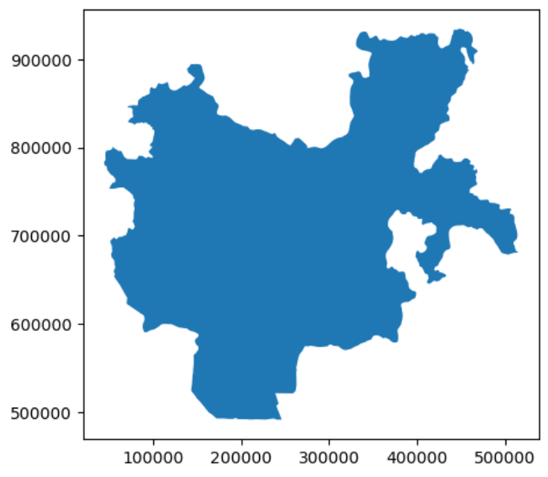
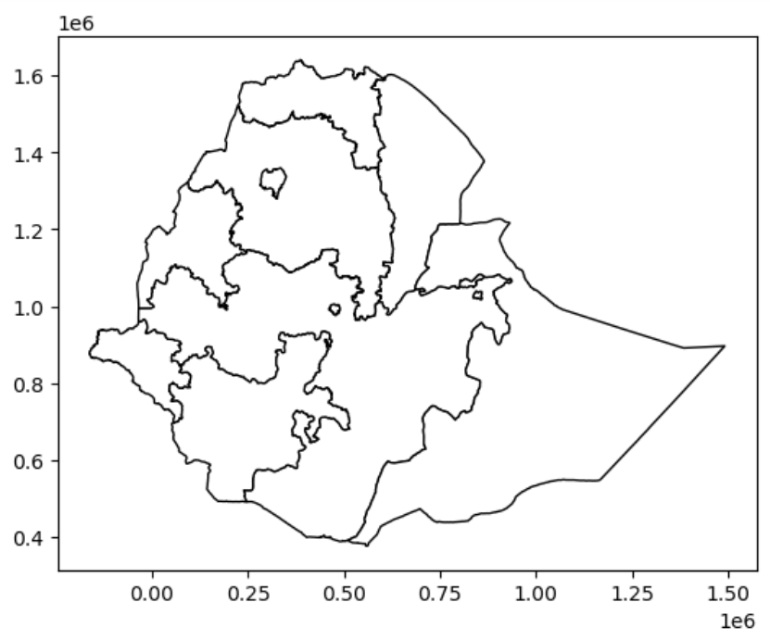
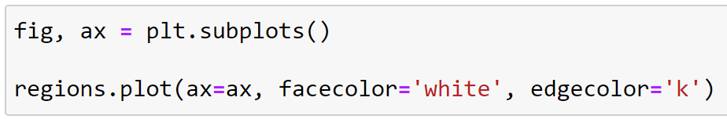
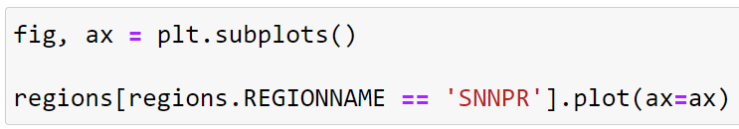
Geopandas – Plotting shape files
Once you have loaded a shapefile, you can easily plot the shapes
Using the function .plot() on the variable

Slide 18
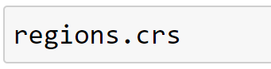
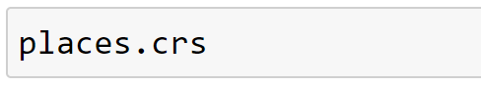
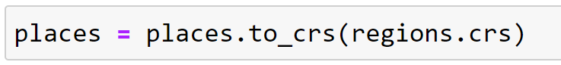
Geopandas – Coordinates
When working with different shape files, make sure the coordinate reference system (CRS) is the same
Checking CRS
Changing CRS
There is also a function to create geographical points from longitude and latitude

Slide 19
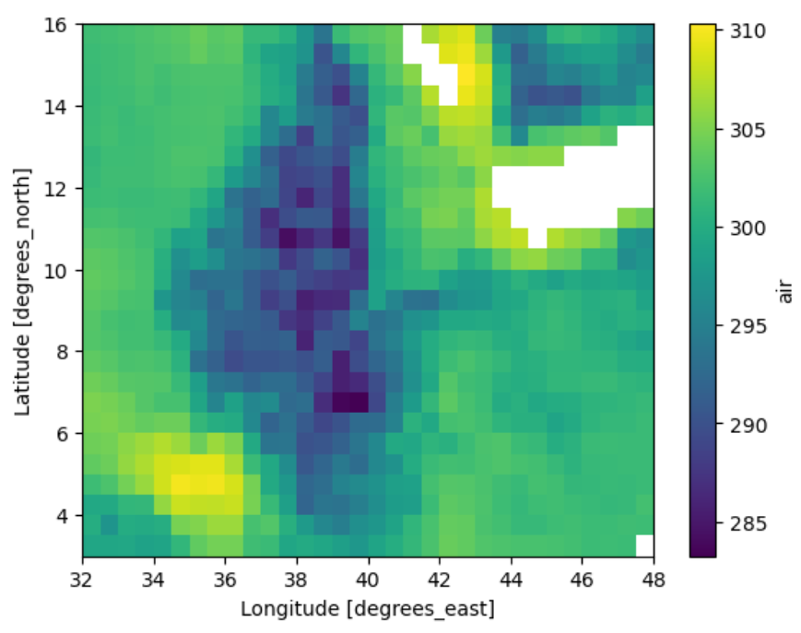
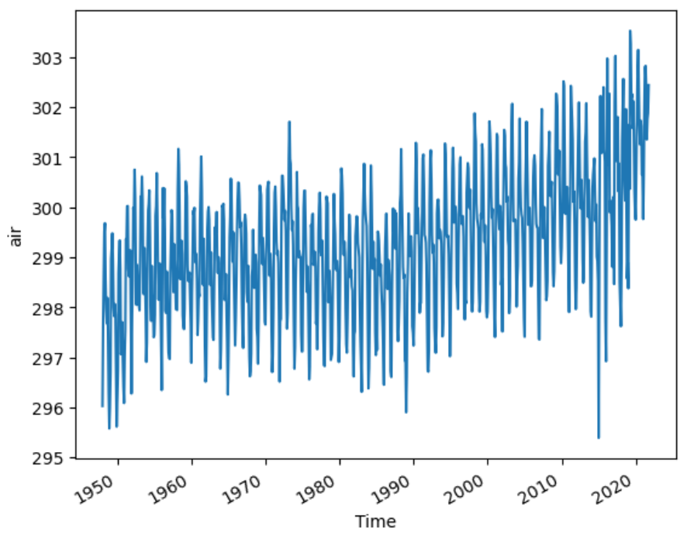
Geopandas – Clipping data based on shape
Until now, when we wanted to select temperature data for a region, we used latitude and longitude boundaries
However, this leaves us with too much data

Slide 20
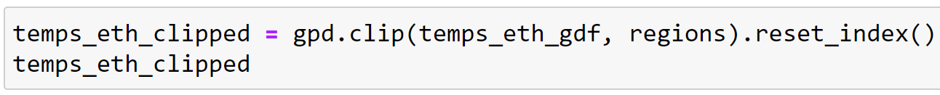
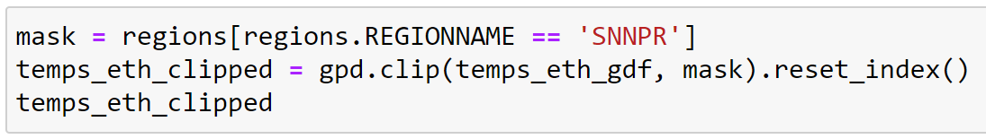
Geopandas – Clipping data based on shape
What we want: only get the data within the shape of Ethiopia
We can use the function .clip(data, mask) to select this data
data – the dataset to select from
mask – the shape(s) to use for selection
The NetCDF data must be transformed to a GeoDataFrame

Slide 21
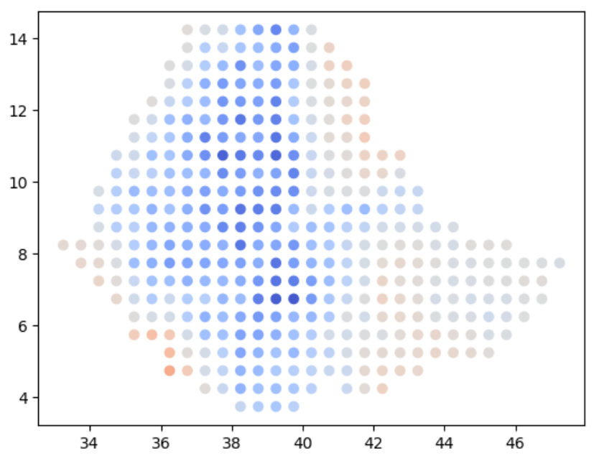
Geopandas – Clipping data based on shape

Slide 22
Plotting on a map – Summary
Multiple options for plotting a contour
Plotting an image
Plotting points on a map
Geopandas
Loading and plotting shape files
Clipping data based on a shape
Arba Minch University | Python training

Slide 23

Good luck!

